Slide 1
Let’s review.
Jenny: Chinese food is great.
Hint: You’re~
Tom :
You’re telling me.
/ you can say
that again.
* I don’t think so.
Cf) I’m telling you. :
정말이야

Slide 2

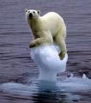
http://www.youtube.com/watch?v=hzyO33fMGMM&feature=fvst
Polar(white) bears
In North Pole
ice

Slide 3
The Objectives
Students will be able to
1. use new vocabulary
2. understand the reading part and answer the questions.

Slide 4


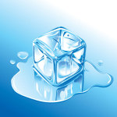
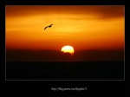
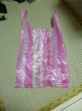
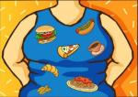

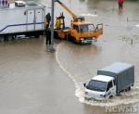
New words
Let’s learn.
appear
light
disappear
melt
rise
Plastic bags
cause
level
sink

Slide 5
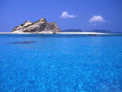


Cause(..을 야기하다.) / Make(..하게 하다)
This will cause many islands ( to disappear / disappear )
She always makes me ( to laugh / laugh )

Slide 6

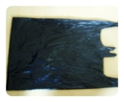
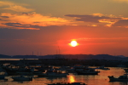
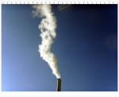

Complete the sentences.
The snowman is in the sun.
Don’t throw away . Recycle them.
The island could in 50 years.
Turn off the when you leave a room.
The sun was in the west.
Smoke was from the chimney.
The sea is rising because of melting ice.
The heavy rain my house to disappear last year.
melting
plastic bags
disappear
light
sinking
rising
level
caused

Slide 7

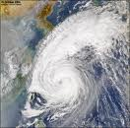
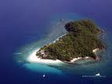

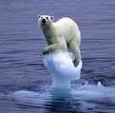

Global warming
원인(cause)
결과(effect)
and more , too
and more..

Slide 8
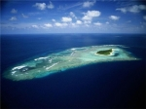

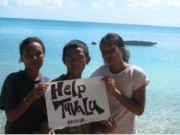
Disappearing Islands
Dear World
Hi, my name is Taukelina. I’m a middle school student living in Tuvalu. Have you heard of Tuvalu?
It’s an island in the Pacific Ocean near Australia. It’s a very small but beautiful island. I’m writing this letter to ask for your help.

Slide 9
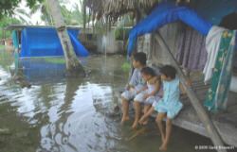
The following paragraph
My country is sinking into the sea.
Do you know why? Global warming caused all this to happen.
Warmer weather makes the ice melt.
Because of the melting ice, the sea level rises.
Some scientists say my country could disappear in 50 years.
I’m very worried.
=Because the ice is melting,

Slide 10
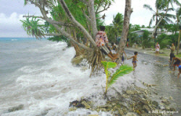
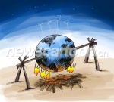
Tuvalu is disappearing. Put the steps in order. p108
a)
The sea level rises.
b)
Global warming
Tuvalu could disappear in 50 years.
c)
Warmer weather makes the ice melt.
d)
Answer) b – d – a - c

Slide 11




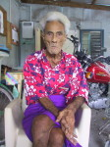
Interview –p109
1)
I couldn’t sleep at all. The sea water was coming into my house.
2)
Because of global warming, the ice is melting. So, the sea level is rising.
3)
I’m going to write a letter and ask people to help us.
4)
I’m worried about the future of our children.
What happened last night?
Why is your country sinking into the sea?
What are you going to do about it?
What are you worried about ?

Slide 12
Formative test
1. It’s in the Pacific Ocean near Australia.
2. To ask for a help.
3. The island is disappearing.
4. The melting ice.
5. Global warming
6. Global warming

Slide 13

Tuvalu
    http://blog.naver.com/siceco/90082291273

Slide 14
Next time
What should we do to stop Global warming?

Slide 15
http://channel.pandora.tv/channel/video.ptv?ch_userid=kyh3423&prgid=37773637

